Slide 1

Customer Shopping Behavior Analysis
3,900 purchases — 18 columns. Goal: uncover spending patterns, segments, product & subscription insights.

Slide 2
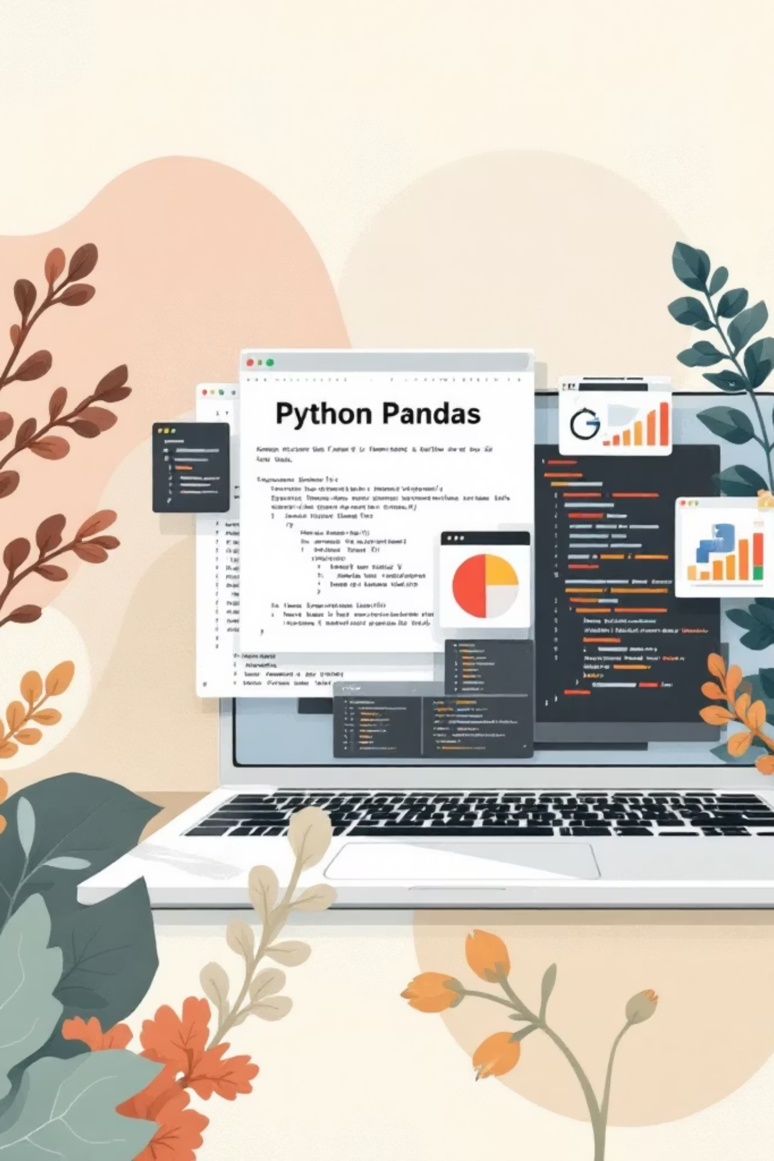
Dataset Summary
Scope
Key Features
Rows: 3,900 · Columns: 18
Demographics, Purchase details, Behavior, Shipping
Missing Data
37 nulls in Review Rating

Slide 3

Exploratory Data Analysis (Python)
Steps
Load with pandas
df.info(), .describe()
Impute Review Rating by category median
Rename columns to snake_case

Slide 4
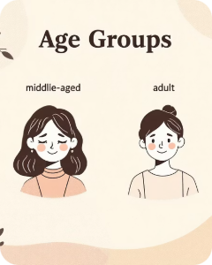

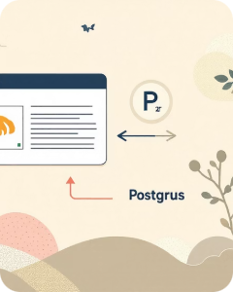
Feature Engineering
Age Group
Frequency
DB Integration
Binned ages → age_group
purchase_frequency_days from timestamps
Load cleaned DF into PostgreSQL for SQL analysis

Slide 5

Revenue by Gender
Totals
Female: 75,191 · Male: 157,890
Insight: Male customers generated ~double revenue.

Slide 6

Discounts & High-Spenders
High-Spending Discount Users
839 rows identified — customers using discounts but spending above average.
Discount-Dependent Products
Top 5 by discount rate: Hat 50%, Sneakers 49.66%, Coat 49.07%, Sweater 48.17%, Pants 47.37%

Slide 7





Top Products & Ratings
Gloves
Sandals
Boots
Hat
Avg Rating 3.86
Avg Rating 3.84
Avg Rating 3.82
Avg Rating 3.80
Skirt
Avg Rating 3.78

Slide 8

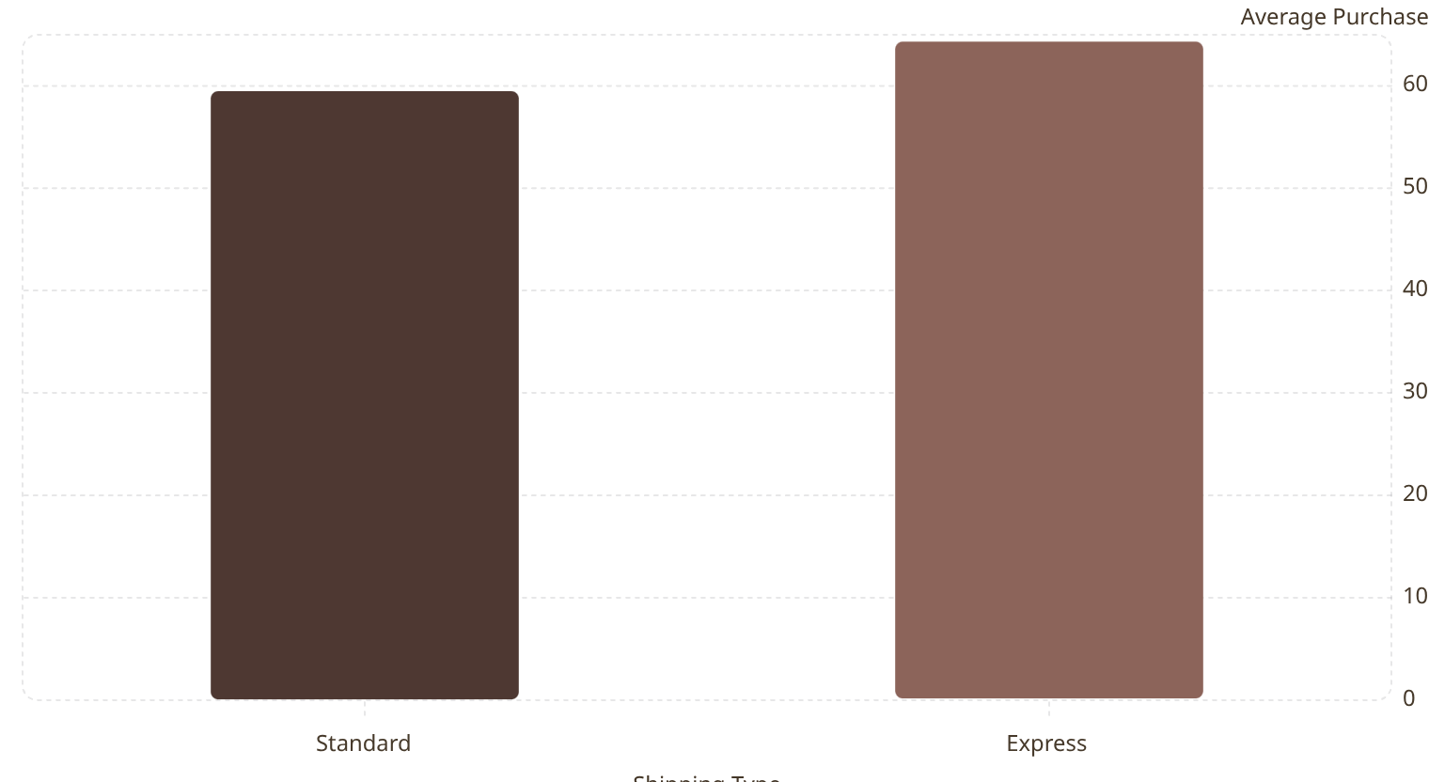
Shipping Type Comparison
Takeaway
Express orders slightly higher average spend (60.48 vs 58.46).

Slide 9
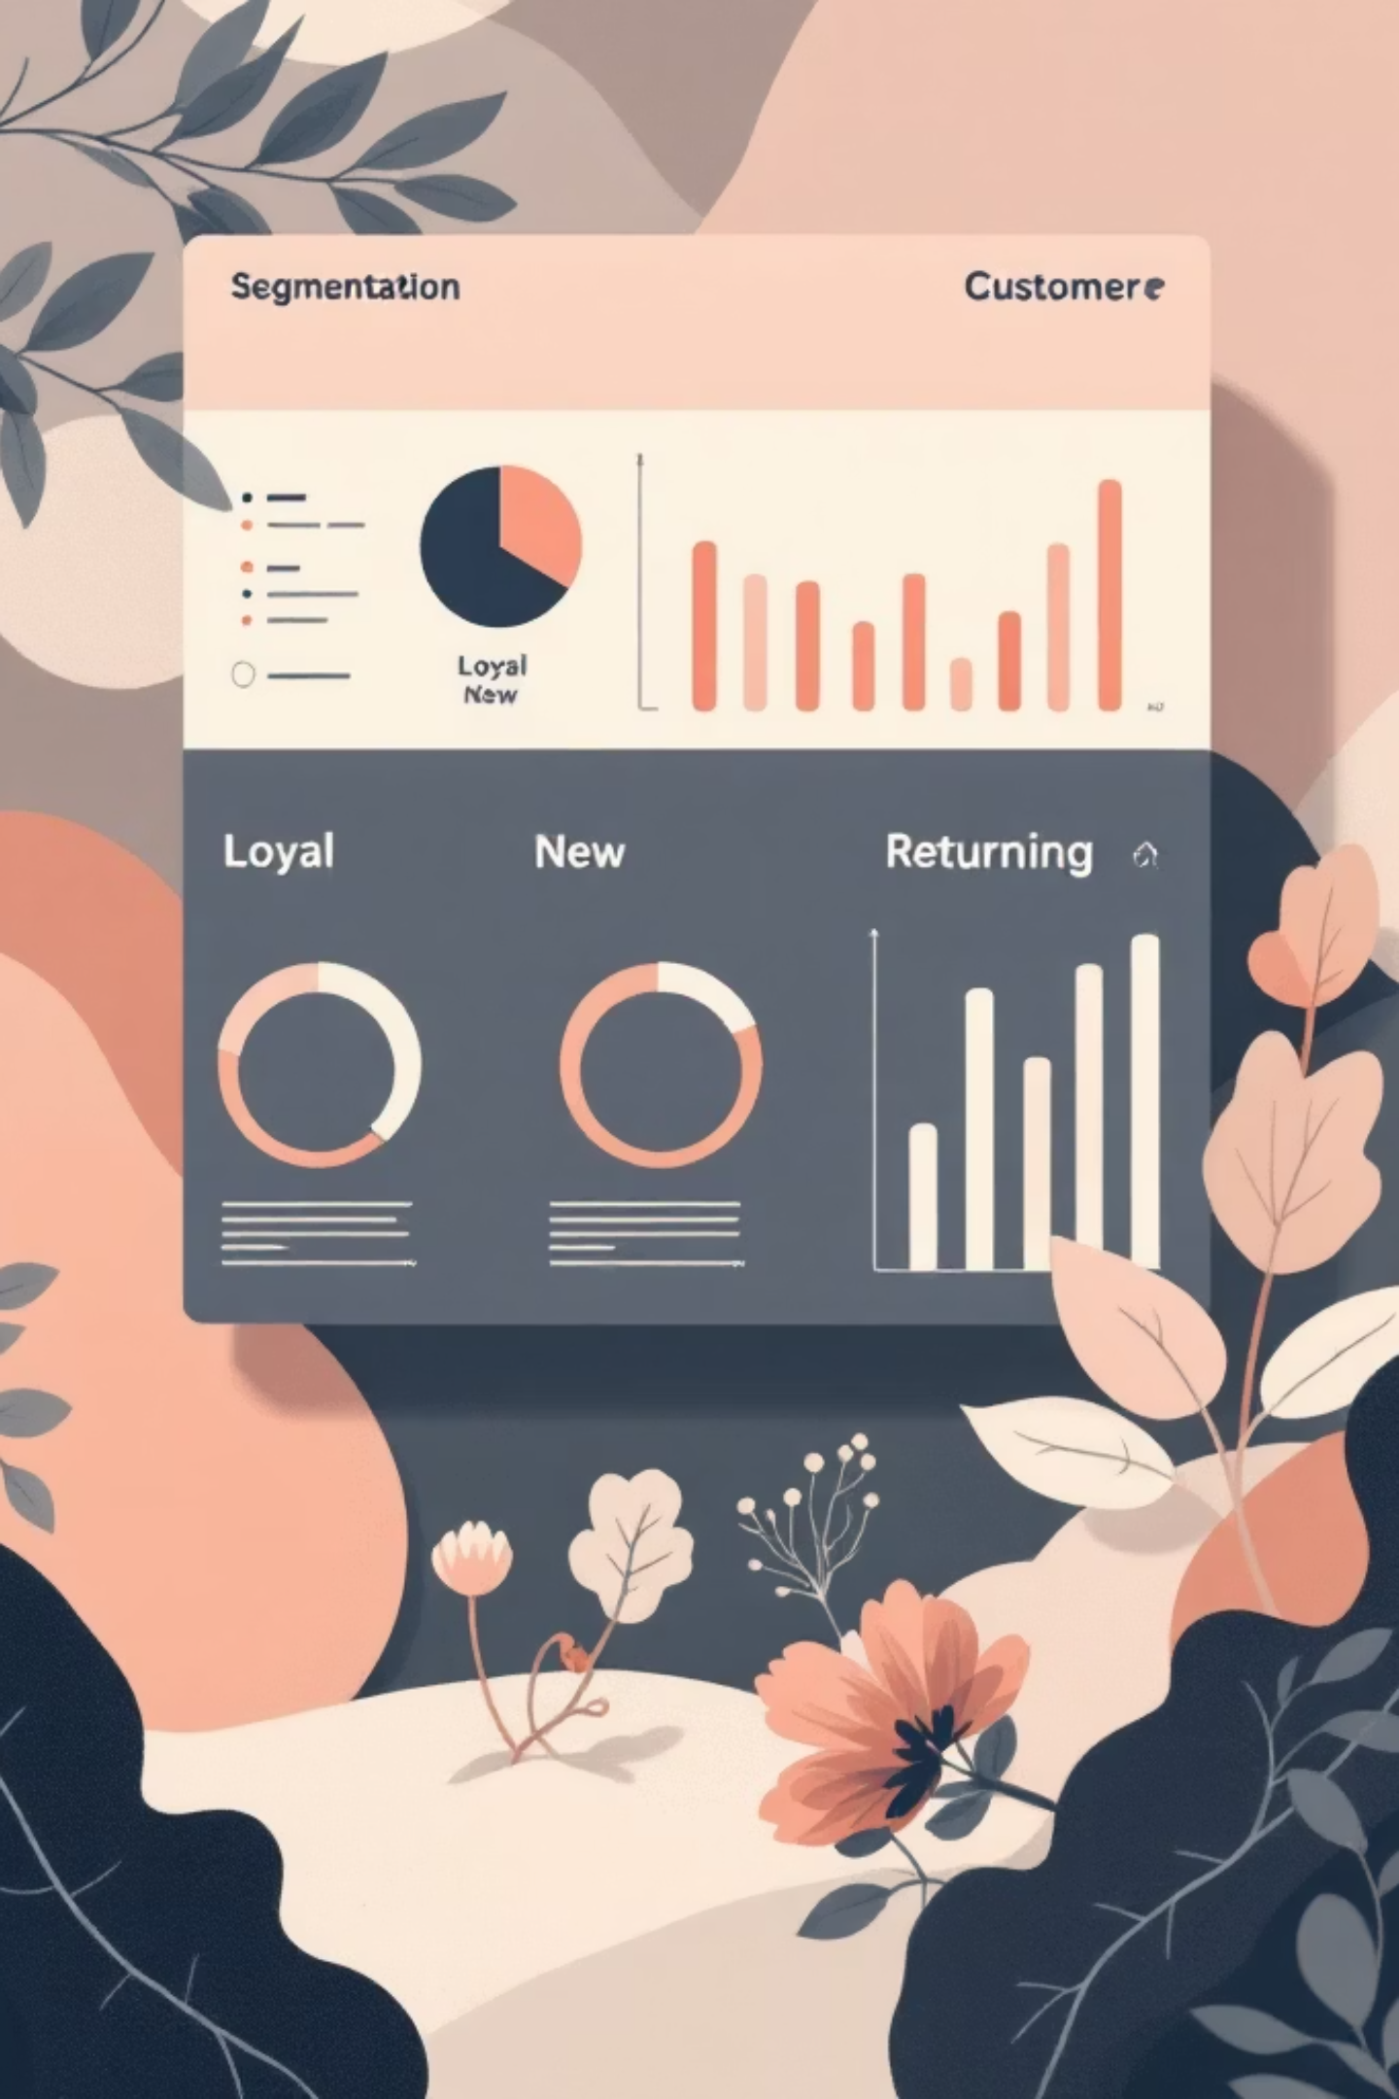

Customer Segmentation & Subscriptions
Loyal
3,116 customers
New
83 customers
Returning
701 customers
Subscription
Yes: 1,053 · No: 2,847 · Avg spend similar (~59.5)

Slide 10
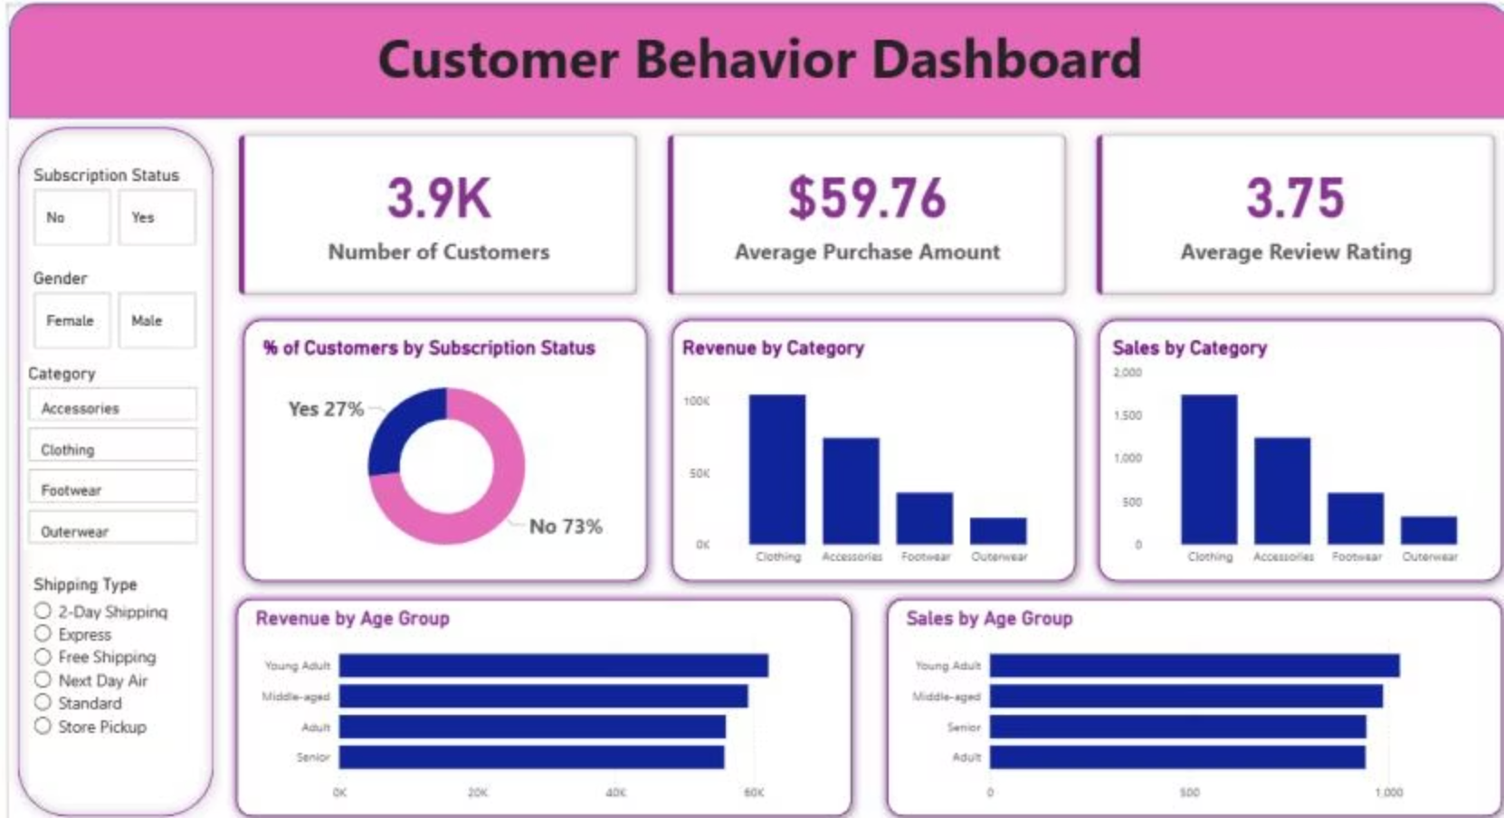
Business Recommendations
Boost Subscriptions
Loyalty Programs
Review Discount Policy
Promote exclusive benefits to increase conversions.
Reward repeat buyers to grow the Loyal segment.
Balance promotional lift with margin control.
Product Positioning
Targeted Marketing
Highlight top-rated & best-selling items in campaigns.
Focus on high-revenue age groups and express-shipping users.

